Slide 1
Bi-stability Analysis of Izhikevich Model
Yoon JaeHong, Zhongxi Li
2017 December

Slide 2
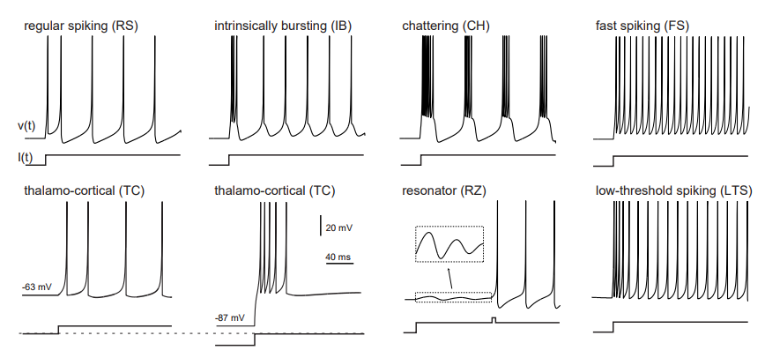
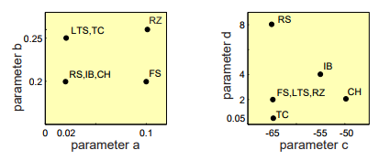
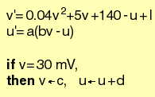
Background
Izhikevich model is a neuron model that
can reproduce wide range of behaviors of cortical neurons; and
is computationally efficient
Izhikevich model
2 state variables
4 parameters
1 input current
Particularly, we are interested in the bi-stability
Electronic version of the figure and reproduction permissions are freely available at www.izhikevich.com

Slide 3
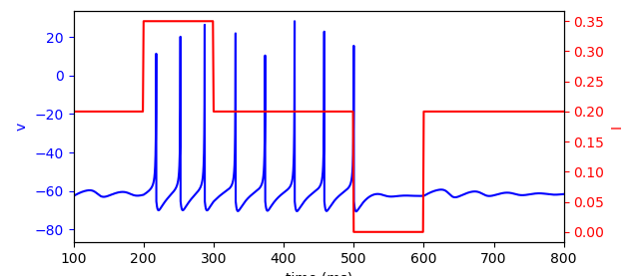
Goal
Bi-stability
Turn on
Our goal is to find and explain a set of parameters that constitute the bi-stability of Izhikevich model.
We believe the bi-stability of the Izhikevich model has some implications of working memory.
Challenges: the Izhikevich model is a hybrid model. It has intrinsic discontinuity.
Turn off

Slide 4
Phase Portrait: An Example
u
saddle point
unstable spirals
v
Notes:
Need to provide more info on how Dr. Izhikevich came up with this artificial resetting.

Slide 5
Methods of Parameter Search
Genetic algorithm → parameter set (a, b)
Izhikevich model
Cross validation
Nonlinear dynamics analysis
Notes:
Need to provide more info on how Dr. Izhikevich came up with this artificial resetting.
Explain why this is somewhat challenging

Slide 6
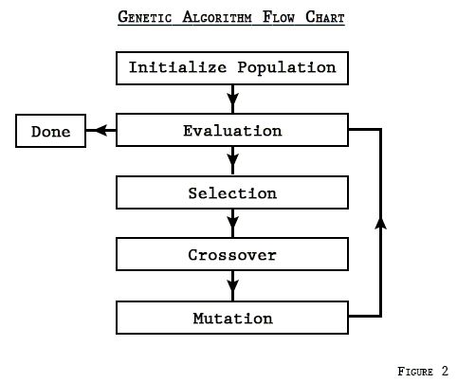
Genetic Algorithm
Basic idea: select the best parameters from a pool of candidates. The best parameters then become parents of the next candidate generation.
Quantify the bi-stability
(1)
(2)
(3)
(4)
(5)
Notes:
First term: can turn on.
Second term: can turn off.

Slide 7
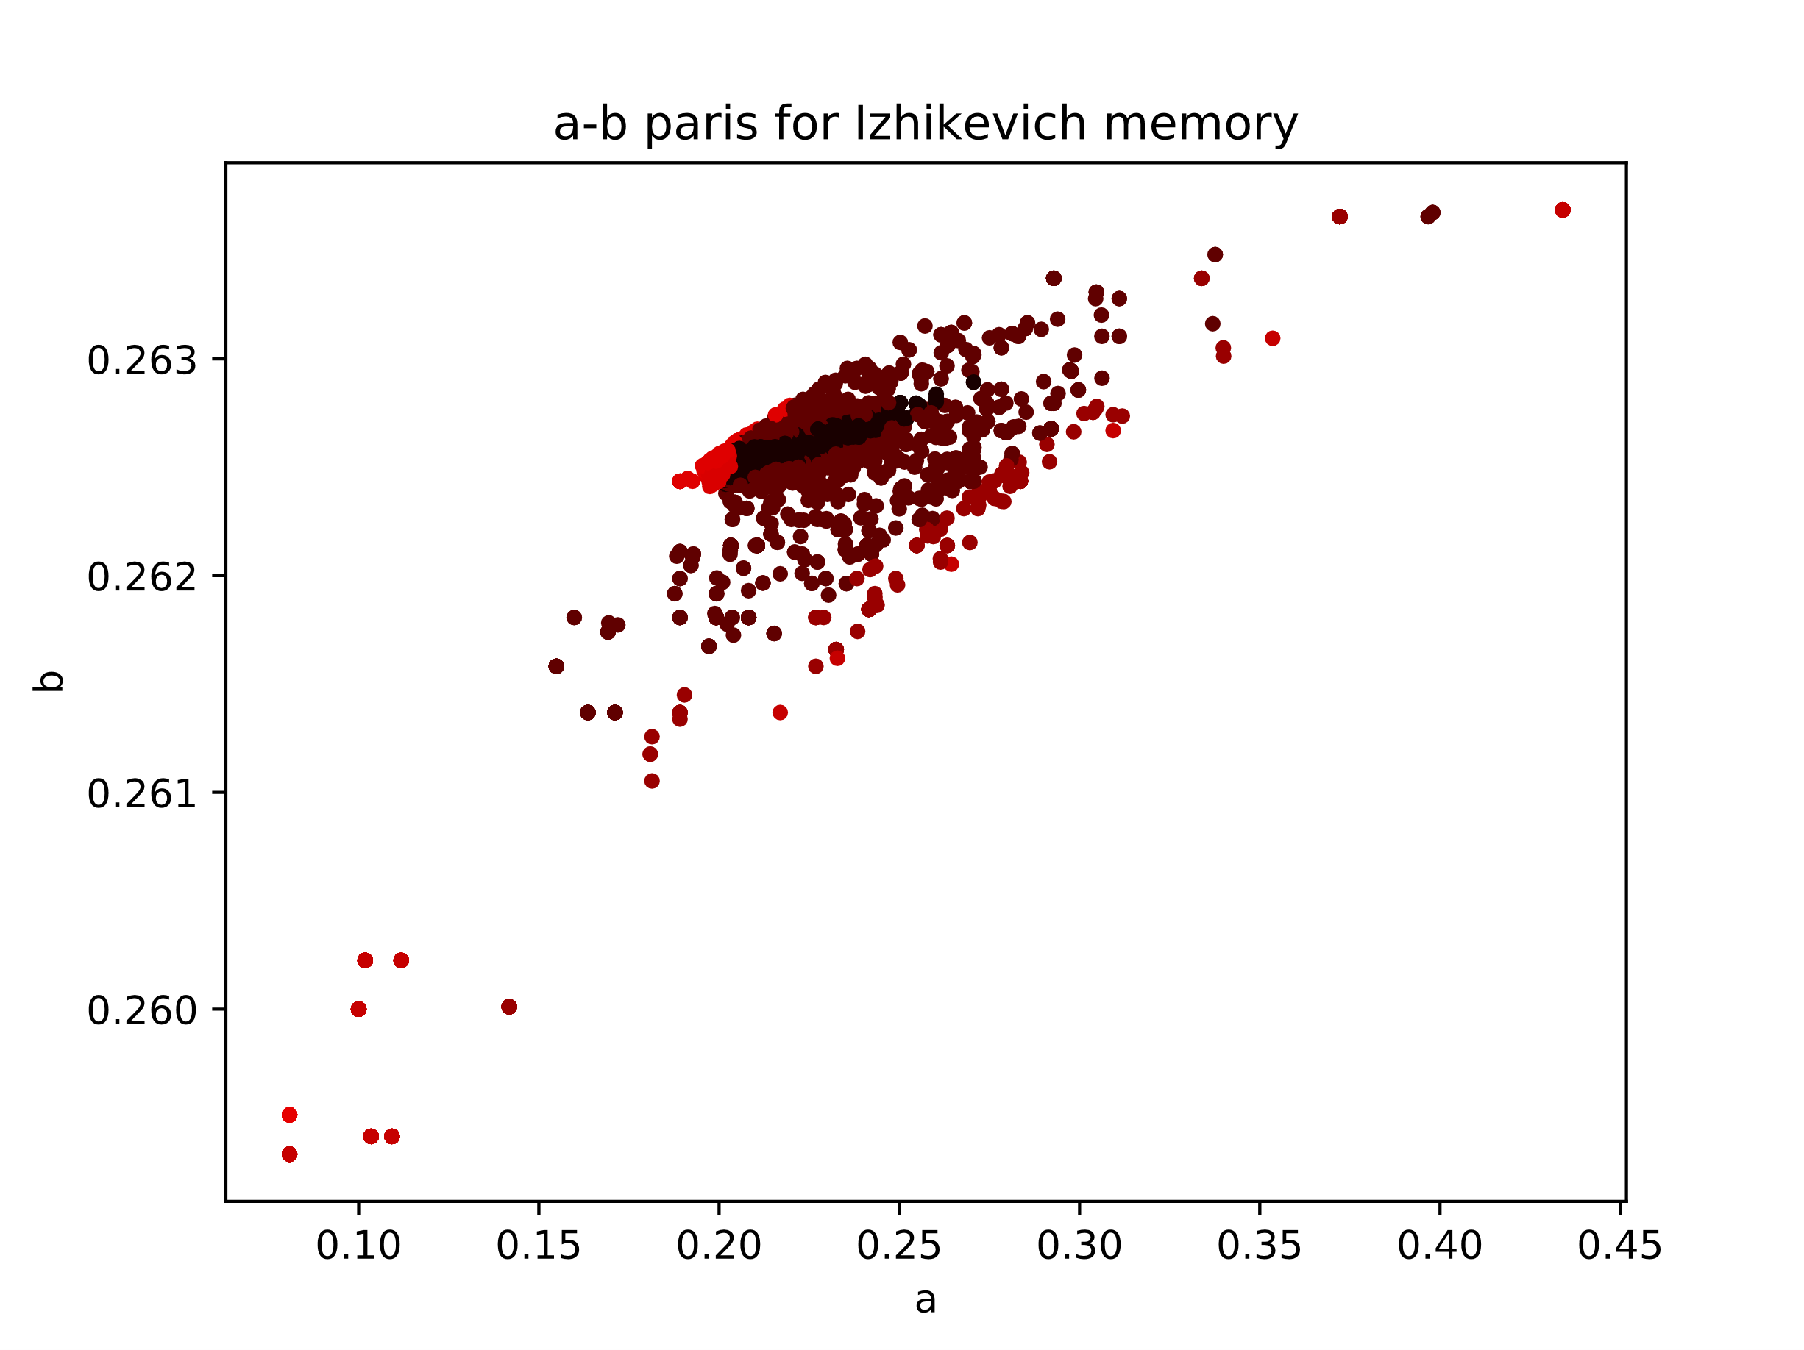
Genetic Algorithm Results
a-b pairs for Izhikevich bi-stability
Different colors represents different reward value
After a > 0.25, there is not much change in b

Slide 8
Bifurcation Analysis
As Nakahara and Doya (1998) argue, working memory possible near bifurcation point
Firing pattern change accordingly to fxpt type
May transit from firing to quiescent
LC occur when fxpt unstable
Quiescent when fxpt stable
Bi-stability of Izhikevich model may be related to Hopf bif
For a fixed (a, b) pair, sweep stimulus current
I = 0.35
Change of stability
Supercritical-Hopf ?
I = 0.15
Notes:
Need to take care of the texts here.

Slide 9
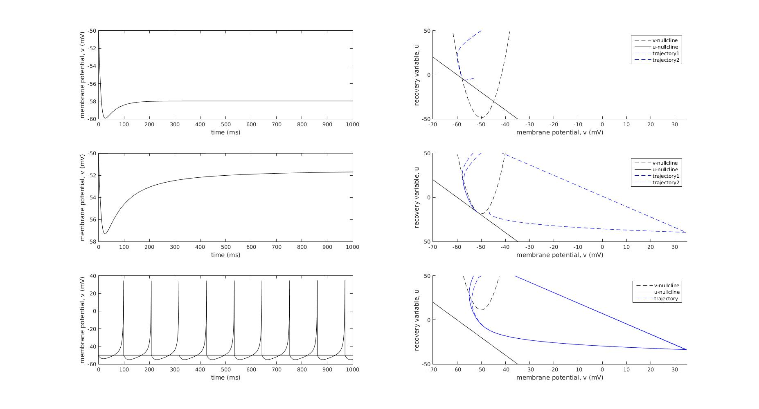
Bifurcation Analysis
Firing pattern observed when
Fxpt is stable
Saddle node bifurcation
No fxpt
Notes:
Need to take care of the bifurcation type here.

Slide 10
Bifurcation Analysis
First, observe phase portraits of an exemple (a, b) = (0.1, 0.26) (reference)
2
1
3
4
5
1
2
3
4
5
u
u
saddle point
u
saddle point
u
saddle point
u
saddle point
saddle point
stable spirals
unstable spirals
stable spirals
stable spirals
stable spirals
v
v
v
v
v

Slide 11
Bifurcation Analysis
Is the limit cycle already there?
Notes:
Need to take care of the bifurcation type here.

Slide 12
Bifurcation Analysis
Analytical solution of (a, b) curve
Fix current I
I = 0.0
There are missing parts
→ Other bifurcation exists
(i.e., fxpt goes across tau=0)
If delta > 0
I = 0.4
Genetic algorithm findings with I switching between 0.2 and 0.35
(a, b) curve
Notes:
Delta > 0 otherwise there is no stability change

Slide 13
Phase portrait of another (a, b) point
(a, b) = (0.2958, 0.263)
saddle point
nothing
saddle point
saddle point
saddle point
stable spirals
stable spirals
stable spirals
stable spirals

Slide 14
Phase portrait of another (a, b) point
For fixed (a, b) = (0.2958, 0.263), sweep the stimulus current
Looks like that a saddle-node bifurcation is causing the bi-stability.
Wrong! The saddle point was already there before the stimulation; it is the annihilation of the fixed points that produce the bi-stability
Notes:
Somehow couldn’t reach the small region near Delta=0, can’t visualize what’s happening inside.

Slide 15
Bifurcation Analysis
Patch parameters that enables saddle-node bifurcation
current I
Due to annihilation of two stable fixed points
Due to Hopf-bifurcation
I = 0.0
I = 0.4
Genetic algorithm findings with I switching between 0.2 and 0.35
(a, b) curve
Notes:
Delta > 0 otherwise there is no stability change

Slide 16
Bifurcation diagram of Izhikevich model
(a, b) corresponding to Evolutionary algorithm
Bifurcation between unstable node vs. stable node (Hopf bifurcation)
Value of ‘b’ converges again
This is due to characteristics of hybrid model
Reduced dimensionality (2D) impossible to have LC
Introduce Afterhyperpolarization reset (AHP rest)
Artificial LC
When a > ~.25, no stable fixed point
AHP induce LC for any b

Slide 17
Bifurcation diagram of Izhikevich model
In Izhikevich model, LC occur in nowhere
No fxpt near LC
As aforementioned due to hybrid model
AHP rest

Slide 18
Conclusion
Genetic algorithm is a good method for parameter searching, provided that the reward function is properly defined.
Izhikevich model’s bi-stability is produced by changing the stimulus current.
Parameters (a, b) that constitute bi-stability involves either supercritical Hopf bifurcation or annihilation of fixed points.
In either cases, a limit cycle already exists.

